Slide 1
Mecanum Drivetrain
Mission to Mars

Slide 2
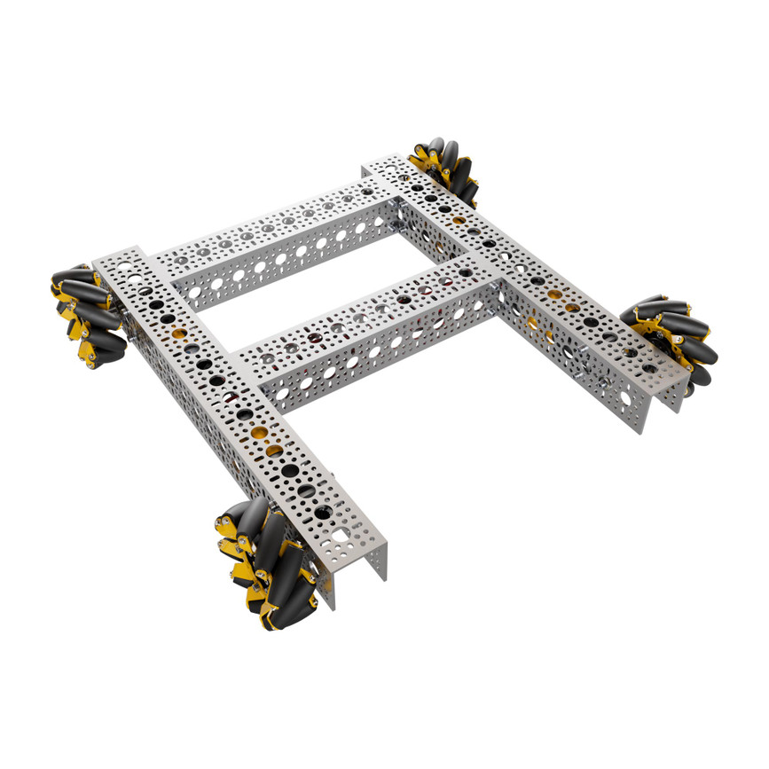
Final Build

Slide 3
GoBilda Strafer Kit
We will use the Strafer Kit from GoBilda:
https://www.gobilda.com/strafer-chassis-kit-104mm-gripforce-mecanum-wheels/
Assembly instructions on the site.

Slide 4
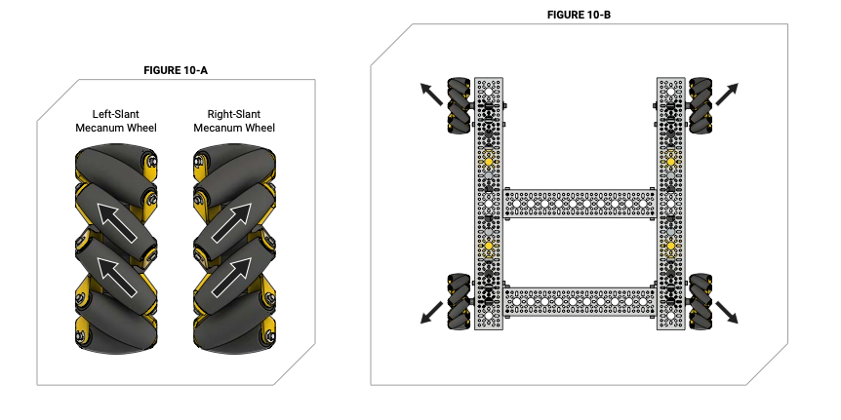
Wheel direction matters

Slide 5
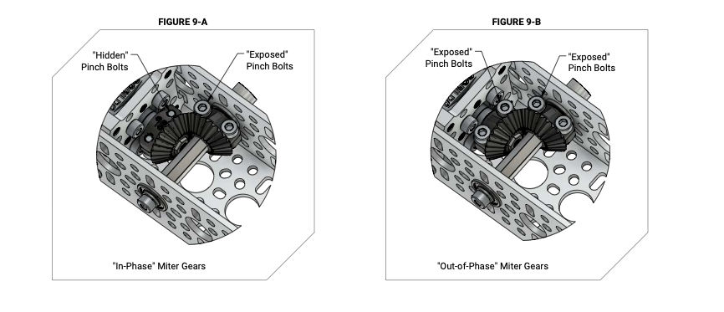
Gearing

Slide 6
Goals
Build a Mecanum drive train
Wire up & Configure Control Hub
Write Code to Enable Teleop Drive

